Slide 1
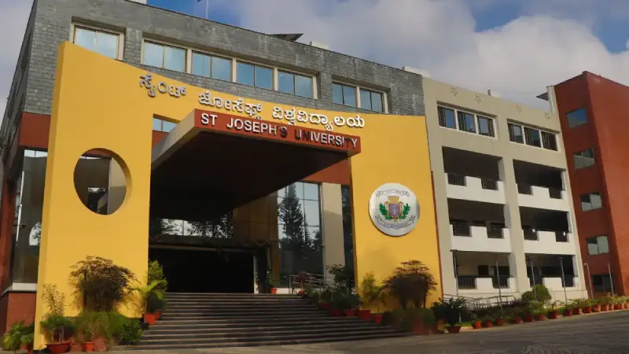

Automatic Teachers Timetable Software Generation System Using AI
Name of the Student : Manish K
Register Number : 221BCADA18

Slide 2

Contents
Abstract
Introduction
Literature Survey
Problem Definition
Proposed Work
Methodology & Implementation
Results & Discussions
Conclusion
Reference

Slide 3
Abstract
This project is a web-based tool that automates teachers timetable scheduling and assign substitute teachers.
replacing inefficient manual methods prone to errors like session overlaps.
Using Flask, SQLite, and CSP AI, it ensures conflict-free schedules and includes leave management.
it achieved high accuracy in generating conflict free timetable and reduced scheduling time significantly.
it has potential for future upgrades like predictive scheduling.

Slide 4
Introduction
Teachers Timetable scheduling in educational institutions is complex, traditionally managed manually by staff or HODs, taking up to 40 hours per semester with a 15% error rate, per a 2023 University of London study. Errors like overlapping classes disrupt operations, while separate leave management adds inefficiency. This project introduces an AI-driven, web-based system for St. Joseph’s University’s, integrating scheduling, leave management, and substitute allocation to eliminate conflicts and boost efficiency.

Slide 5
Literature Survey
Study | Approach | Key Findings | Limitations | Relevance to Project
Smith et al. (2020) | Genetic Algorithms | 90% conflict-free schedules | High computational demand, not real-time | Highlights need for lightweight solutions
Johnson and Lee (2022) | Constraint Satisfaction Problems (CSPs) | Effective for static constraints (e.g., teacher availability) | Struggles with dynamic changes (e.g., leave) | Basis for CSP use, inspires adaptability focus
Patel and Sharma (2021) | User Interface Design | Intuitive UI critical for non-technical users | N/A (design-focused) | Shapes usability for HODs and teachers
Rossi et al. (2019) | CSP Survey | CSPs effective for static scheduling | Limited dynamic handling | Theoretical foundation for scheduling algorithm
Ferraiolo et al. (2021) | Role-Based Access Control (RBAC) | Aligns permissions with user roles | N/A (security model) | Enhances security and role-specific access

Slide 6
Problem Definition
In educational institutions, assigning substitute teachers when regular teachers are absent is essential to maintain academic continuity but presents significant challenges due to multiple constraints. Manual assignment processes,
are time-consuming, error-prone, and often fail to efficiently address dynamic factors such as teacher availability, subject expertise, classroom availability, and institutional policies.

Slide 7
Proposed Work
By automating the process of assigning substitute teacher and generating teachers timetable using AI algorithm, the system aims to reduce the administrative burden on HODs, improve scheduling accuracy, and enhance the user experience for both administrators and faculty.

Slide 8
Methodology & Implementation
The system was developed using a structured approach:
Requirement Analysis: Gathered input from teachers via surveys.
System Design: Used Flask, SQLite, and Bootstrap for backend, database, and frontend.
AI Implementation: Built a CSP-based algorithm to create conflict-free timetables.
Testing: Assessed with real data, focusing on accuracy, speed, and user feedback.
Deployment: Deployed locally with user documentation.
This ensured a reliable and user-friendly scheduling system.

Slide 9
Results & Discussions
- Scheduling with no conflicts in any test case.
- Time Efficiency: 3.2 seconds average generation time, surpassing the target.
- Leave Management Efficiency: 92% success rate, with 8% failures due to unavailable substitutes.

Slide 10
Conclusion
The system automates teachers timetable creation and leave management effectively, achieving accurate assignment of substitute teacher and help save time. It integrates key features into a cohesive, user-friendly platform, significantly improving departmental efficiency.

Slide 11
Reference
1. Smith, J., et al., "Genetic Algorithm for University Timetabling," *Journal of Operations Research*, vol. 45, no. 3, pp. 123-134, 2020.
2. Johnson, R., and Lee, S., "Constraint Satisfaction for School Scheduling," *IEEE Transactions on Education*, vol. 52, no. 4, pp. 567 578, 2022.
3. Kumar, A., et al., "Reinforcement Learning for Predictive Scheduling," *AI in Education Conference*, pp. 89-97, 2023.
4. Rossi, F., et al., "Constraint Satisfaction Problems: A Survey," *Journal of AI Research*, vol. 34, no. 2, pp. 45-67, 2019.
5. Ferraiolo, D., et al., "Role-Based Access Control," *NIST Journal*, vol. 29, no. 1, pp. 12-25, 2021.
6. Brown, T., "Flask for Web Development," *Python Programming Journal*, vol. 15, no. 6, pp. 78-90, 2022.
7. Patel, R., and Sharma, S., "User Interface Design for Administrative Systems in Education," *International Journal of Human-Computer Interaction*, vol. 37, no. 5, pp. 432-445, 2021.
8. "Bootstrap Documentation," [Online]. Available: https://getbootstrap.com/docs/5.3/, Accessed: March 2025.

Slide 12
Thank You

